Slide 1
COURSE C++ 1 THE BASICS
By CSTUDIO

Slide 2
SUMMARY
A little word about me
What to expect from these courses
The history of C++
Practise : Install the tools
Hello, World !
Types & Variables
Conditions & Loops
Input / Output
Practise : Game of hot & cold, Money change
Arrays, strings and dictionaries (an introduction)
Functions
Practise : Hanged Man

Slide 3


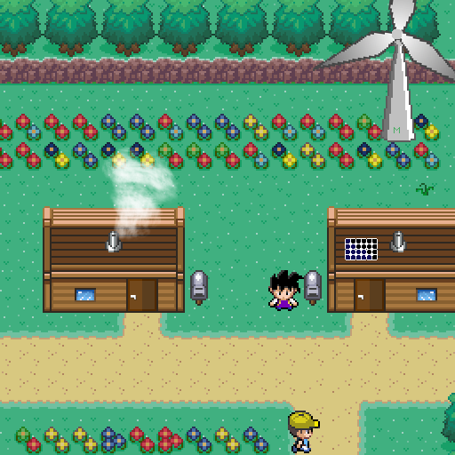
A little word about me
github.com/srykah
Parallelization of quantum computing algorithms in C++
New C++ developer on OpMon, a free and open source of Pokémon !

Slide 4
What to expect from these courses
Complements online tutorials, not replace them
Warns about pitfalls and teaches about best practises
Vast subject and short time : please focus !
You will have to experiment at home to make sure you understood everything well and to solidify your learning
I might skip some slides : feel free to read them at home and reach me for questions !

Slide 5
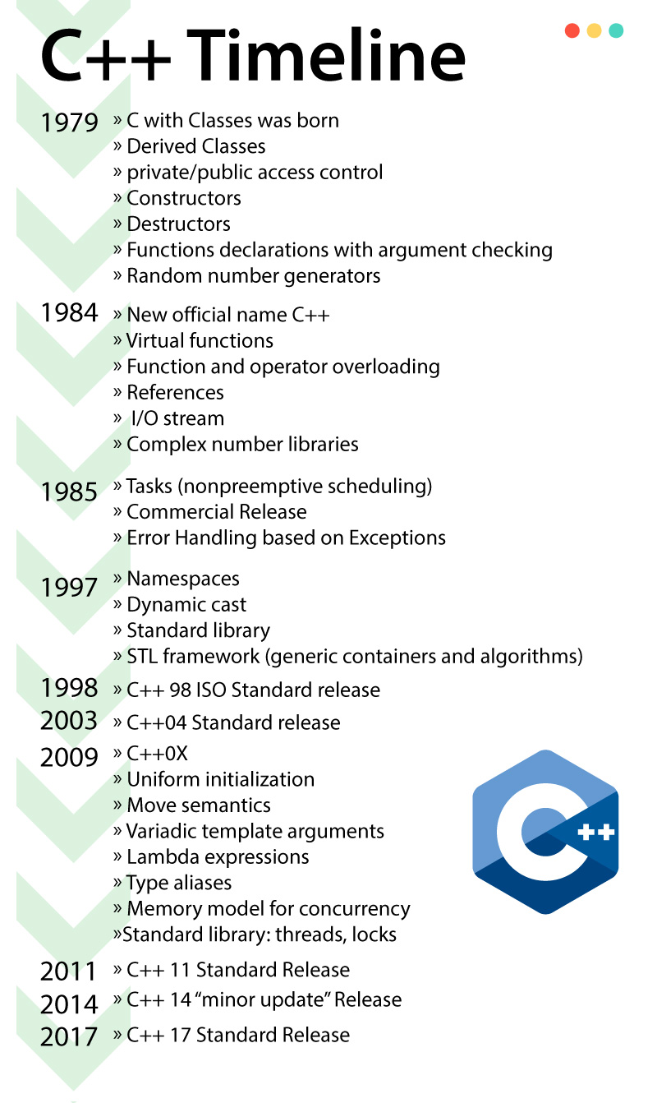
The history of C++
1979 : Creation of “C with Classes” by Bjarne Stroustrup in AT&T’s Bell Labs
1984 : Name change : “C++”
1998 : Standardization by ISO
2003 : “Bugfixes” of C++98’s standard
2011 : New major release of the C++ standard, the next releases will happen every 3 years
2014 : New (small) release
2017 : New (average) release
2020 : Next planned release, will bring major updates like Concepts, Ranges, Coroutines and Modules

Slide 6
Practise : Install the tools
For Windows :
In a folder whose path does not contain spaces or accentuated characters (like C:\prog\tools) :
MinGW-w64 : https://sourceforge.net/projects/mingw-w64/
CMake : https://cmake.org/download/
Git : https://git-scm.com/downloads
Doxygen : https://sourceforge.net/projects/doxygen/files/snapshots/
Visual Studio Code : https://code.visualstudio.com/
C/C++ plugin by Microsoft
CMake Tools plugin by Microsoft
Doxygen Documentation Generator plugin by Christoph Schlosser
Don’t forget to add the tools to the PATH ! (It should be suggested in the installers)

Slide 7
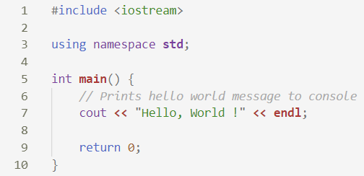
Hello, World !

Slide 8


Hello, World !
We will use the input / output module of the standard library
(more about input / output later)
Elements in the standard library are referred to as, for example, std::cout or std::endl. This line allows us to simply write cout and endl.

Slide 9
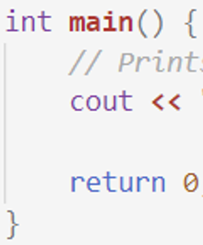

Hello, World !
The program’s main function : a program starts by this function and end at its exit.
This line prints « Hello, World ! » to the console with a new line at the end.
Always remember to end instructions with a semicolon !
No error : the main function returns 0 (more about returns later)

Slide 10
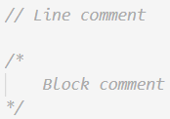
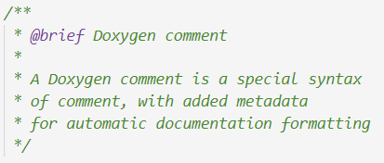
Comments
Comments are super important !
Even if you’re alone as the size of your projects increase you won’t be able to remember it all !
There is also a tool named Doxygen that helps create nice-looking documentations thanks to specially formatted comments !

Slide 11
Types and Variables
In C++, each variable has a type that is known at compile-time and that cannot change. Here are the most used fundamental types and their corresponding literals :
bool : boolean values (true, false)
char : characters (‘a’, the character ‘8’, the new line character ‘\n’)
int : integers
Can have modifiers :
signed (default) vs unsigned
short, long and long long
float, double, long double : floating-point numbers (what you use to approximate real numbers)
Careful with those ! Explaining why would be pretty long so just trust me, they’re really weird sometimes…
Note : 1 == sizeof(char) <= sizeof(short) <= sizeof(int) <= sizeof(long) <= sizeof(long long)

Slide 12
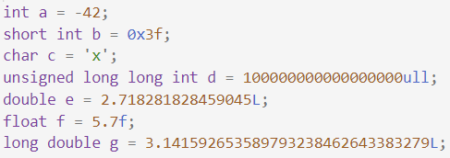
DeclarE your own variables !

Slide 13

ConstantS
Constants are variables that can’t be modified.
They can be useful for setting parameters : with the right name, they arre en example of self-documenting code !

Slide 14
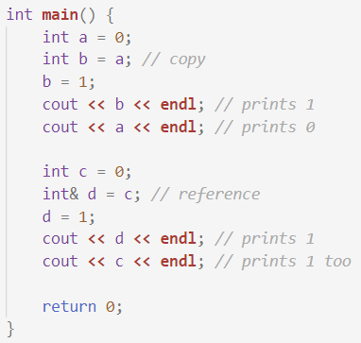
References
References behave exactly like the variable they reference : the variable and the reference share the same space in memory.
They cannot exist without a variable to reference, and they cannot change the variable they reference.

Slide 15
Booleans
bool : type that can only hold two values, « true » and « false ».
Boolean operators :
logical AND : &&
logical OR : ||
logical NOT : !
equality : == (notice the double equal sign)
inequality : !=
comparisons : >, <, >=, <=

Slide 16
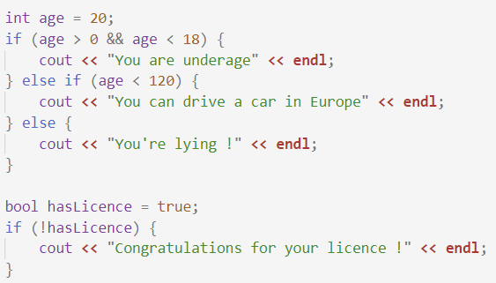
Conditions

Slide 17
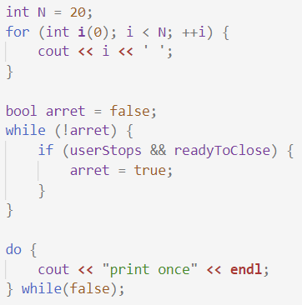
Loops

Slide 18
Input / Output
In C++, input / output is made via « streams » : for example, <iostream> is for console input / output, whereas <fstream> is for files
They all use the same syntax :
<< for insertion
>> for extraction
In <iostream>, two standard streams are defined : cout for outputting to the console, and cin for extracting from the console

Slide 19
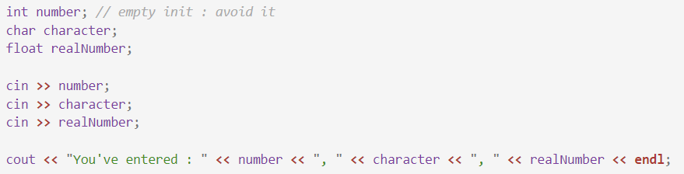
Input / Output

Slide 20
Practise : game of hot & cold, Money change
With your neighbour, try programming one or both of the following examples :
Game of hot and cold : the first player enters a number, and the second must find it. When the new guess is closer to the answer than the last guess, output « You’re hot ! » ; otherwise, output « You’re cold ! ».
Money change : the person enters a money value, and you have to tell him how many bills and coins of Euros this represents (remember, the bill and coin values are 500€, 200€, 100€, 50€, 20€, 10€, 5€, 2€, 1€, 50cts, 20cts, 10cts, 5cts, 2cts & 1ct).

Slide 21
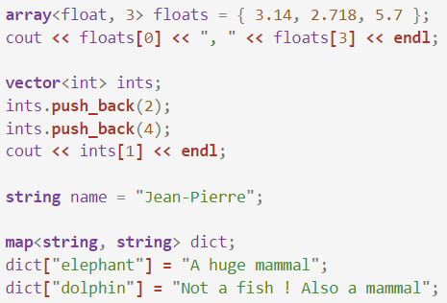
Arrays, strings and dictionaries

Slide 22
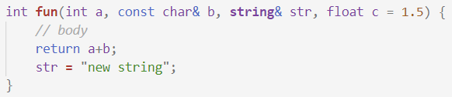
Functions

Slide 23
Practice : Hanged Man
Program a hanged man game !
The first player chooses a word
The other player tries to guess the letters in the word
He can guess a wrong letter 10 times
When he guesses the last letter of the word, he wins
Letters guessed correctly are printed in the word

